Slide 1




BANK ANALYSIS
By Group 1
23 July 2023

Slide 2











PRESENTATION OUTLINE
TEAM MEMBERS
CONCULSION
INTRODUCTION
KPI'S
DATASET OVERVIEW

Slide 3


Meet Our Team
Abhishek Navle
Business Analyst
Rahul Kumar
Research Analyst
Chandrashekar Reddy
Powerbi Developer
Dhanashree Suresh Koli
Tableau Specialist
Kalpana Pattnaik
SQL Developer
Heena Jamal
Data Analyst

Slide 4
About Company
As one of the top financial institutions in the industry, AstralBank has been serving customers with unwavering commitment for over 15 years. With a strong focus on innovation and customer satisfaction, we offer a comprehensive range of banking services to individuals, businesses, and corporations. Our dedication to providing top-notch solutions has earned us trust and loyalty from millions of customers worldwide.

Slide 5



Project Goal
To analyze the financial performance of the bank using Tableau, Power BI, SQL, and Excel. The analysis focuses on five KPIs crucial for assessing the bank's financial health. By examining these key performance indicators, we aim to identify significant points that can help improve the bank's overall performance.
Key Performance Indicators (KPIs)
Loan Amount Trends by Year: Analyzing the loan amount statistics over different years.
Revolving Balance for Grades and Sub-grades: Examining the revolving balance based on loan grades and sub-grades.
Payments: Verified vs. Non-Verified: Comparing total payments for loans with verified status against non-verified status.
Loan Status across States and Last Credit Pull Date: Studying loan status based on states and the last credit pull date.
Home Ownership vs. Last Payment Date: Understanding the relationship between home ownership and the last payment date.

Slide 6
DATASET OVERVIEW
Data Format: The dataset is provided in CSV (Comma-Separated Values) format.
Total records: 39,718 records in both files
Data Columns: The dataset consists of several essential columns, including loan_status, home_ownership, issue_date, & loan_amount, etc. allowing us to explore various facets of the bank's performance.
Data Period: Our analysis covers a comprehensive period from 2007 to 2016, providing a holistic view of the bank's financial activities.
Data Cleaning: Prior to analysis, we meticulously cleaned the data, addressing missing values and resolving inconsistencies, ensuring the reliability of our findings.
Tools Used: Excel, SQL, Powerbi & Tableau.
Joining/Merging: To form a unified dataset, we performed a join/merge operation on the two CSV files using specific join/merge technique, aligning the data based on the
common column ID.

Slide 7
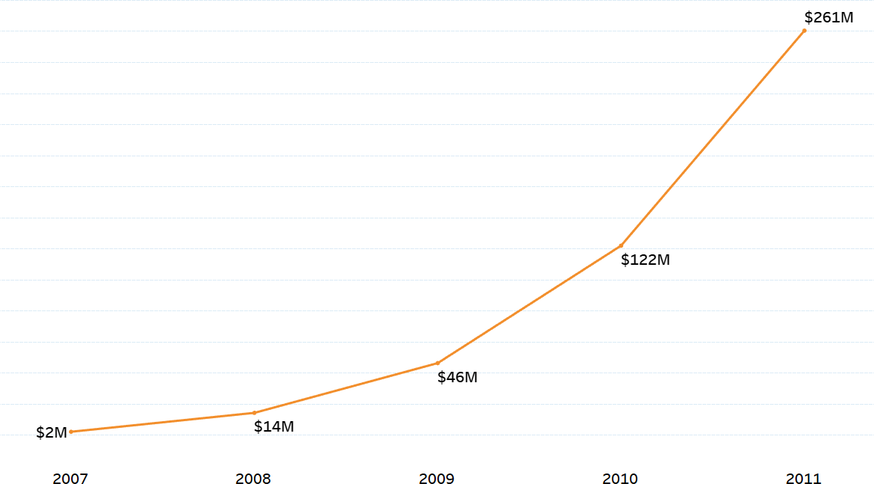

Loan Amount Trends by Year
Observations
The loan amount has increased steadily over the past 5 years.
The most significant change in loan amount occurred between 2007 and 2008, when the loan amount increased by 650%

Slide 8
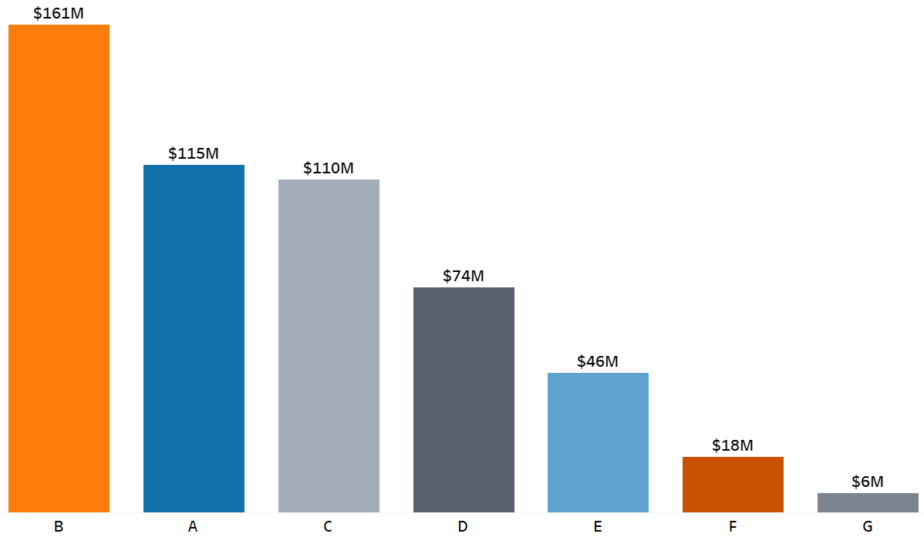

Revolving Balance for Grades
Observations
The total revolving balance for all grades is
$591,994,868
Grades A and C exhibit competitive borrowing behavior, with Grade A at
$114,774,099 and Grade C at $110,120,710.
Grade B has the highest revolving balance at $161,308,549, indicating its popularity among borrowers.
Grade G to Grade B: 2,442% difference, largest gap.
Grades G, F, and E have lower revolving balances, possibly catering to niche borrowers.
Grades

Slide 9
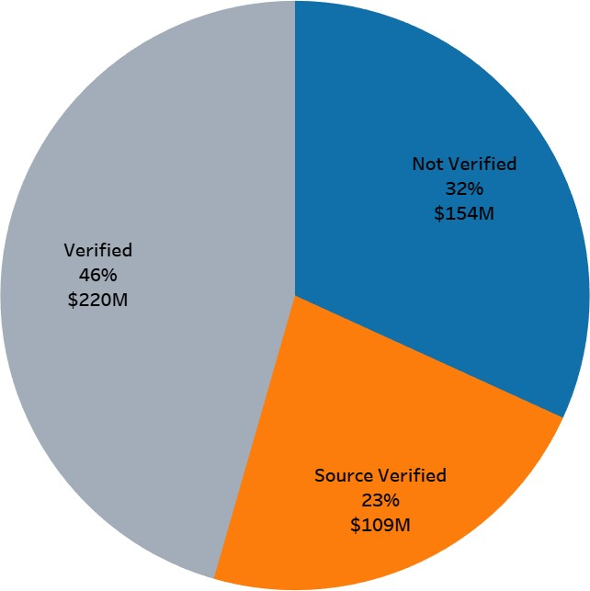

Payments: Verified vs. Non-Verified
Observations
Total payments value is $482,704,393.92.
Verified: 45.55% highest share of payments- Indicates a preference for secure and trusted payment methods, undergoing comprehensive verification.
Payments with some form of verification (Source Verified and Verified) make up 68.19% of the total payments.
Not Verified: 31.81% - Likely due to customers opting for quicker transactions or not meeting criteria for additional verification.

Slide 10
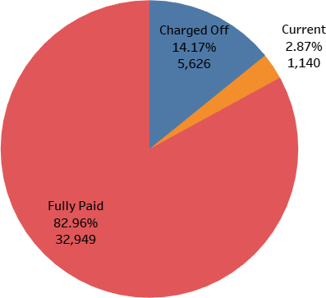


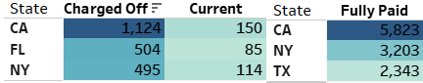
Loan Status across States
Observations
The data shows that most loans (82.96%) are categorized as "Fully Paid," indicating a high level of successful loan repayment.
Charged off loans account for 14.17% of the total count, which suggests a non-negligible portion of loans that have not been repaid and may have adverse effects on the lender's financials.
2.87% of the total loans are categorized as "Current," indicating that a small portion of borrowers are actively repaying their loans at the moment.
Observations
California has the most fully paid loans (5,823) and the most charged- off loans (1,124).
Top 3 States in all three Categories
New York has the second most fully paid loans (3,203) and the second most charged-off loans (495).
Texas has the third most fully paid loans (2,343). Florida has the third most current loans (85).

Slide 11
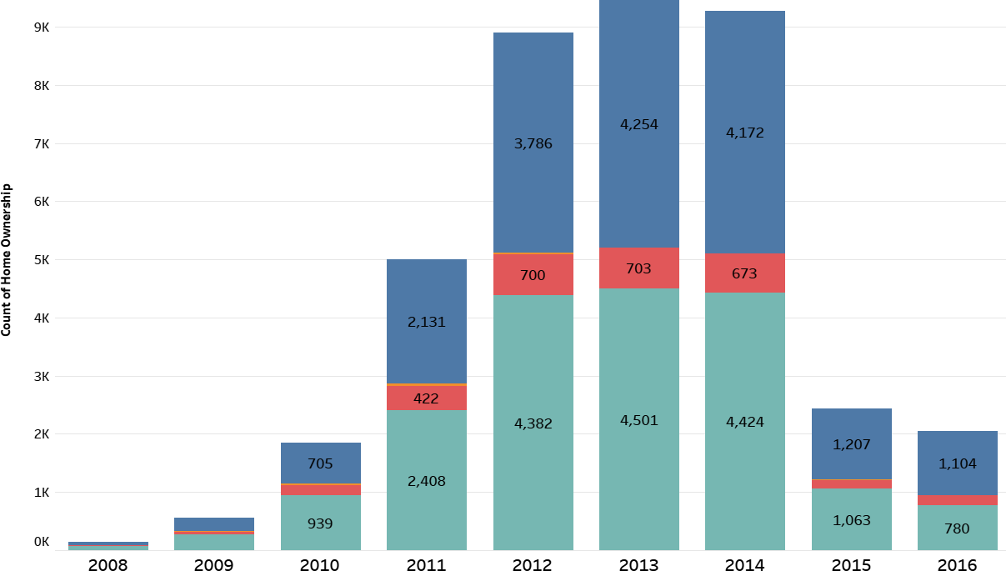

Home Ownership vs. Last Payment Date
Observations
Renters declined from 939 (2010) to 780
(2016), a 17% decrease.
Mortgage holders surged remarkably from
56 (2008) to 1,104 (2016), a 1871% increase
Mortgage is the most common type of home ownership, with 4,501 people owning their homes through a mortgage, followed by rent (4,382 people), own (4,254 people), and other (13 people).
Focus on the years 2010 and 2015, where significant changes in home ownership and rental preferences occurred, potentially related to economic conditions.

Slide 12



Conclusion
Mortgage Product Portfolio Expansion: Given the significant 1871% surge in mortgage holders, focus on expanding the bank's mortgage product portfolio with competitive interest rates and flexible terms to capture the increasing demand.
California had the most fully paid loans (5,823) and the most charged-off loans (1,124). This suggests that California is a major market for the bank. The bank can market its products and services in California by attending industry events, running targeted advertising campaigns, and partnering with local businesses.
Rental Property Financing Solutions: With rental preferences declining by 17%, develop specialized loan products for rental property financing, catering to the needs of customers who prefer renting over homeownership.
Grade-Based Loan Promotions: Promote Grade B loans with attractive terms and benefits to capitalize on its popularity among borrowers, increasing loan uptake in this segment.
In the US housing market, 2010 marked post-Great Recession recovery, with declining mortgage holders and rising renters. By 2015, the market improved, leading to increased mortgage holders, while renters remained stable.

Slide 13
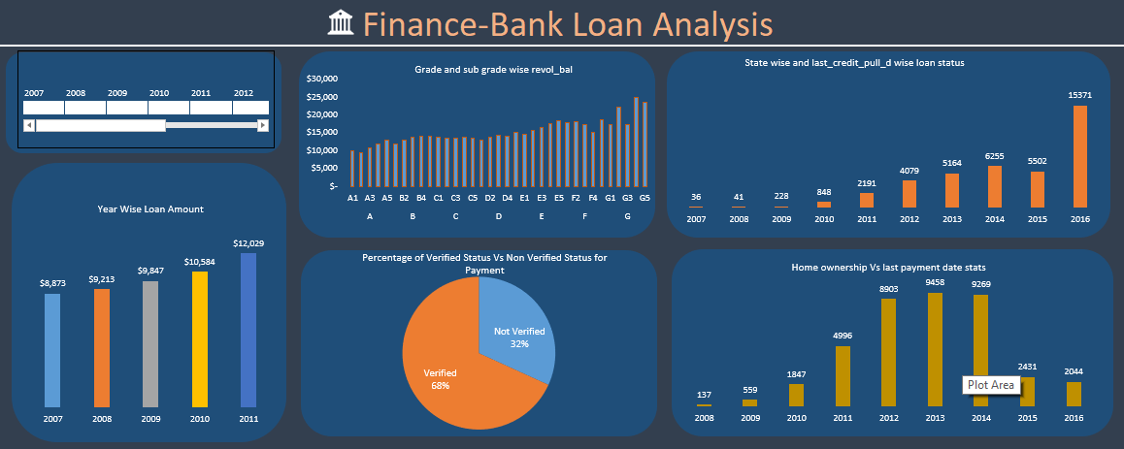
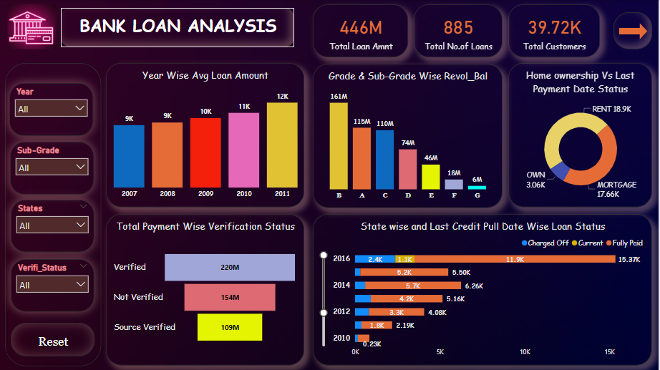
Dashboard

Slide 14






Thank You

